Slide 1
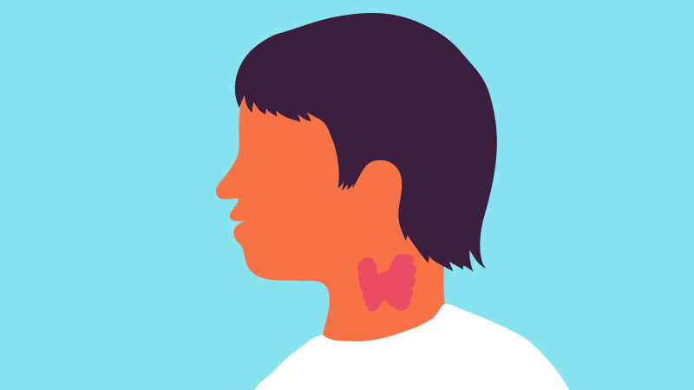
hypothyroidism & Diffuse toxic goiter (Graves' disease, Basedow disease)
JSC “Astana medical university”
Department of inner diseases №1
Made by: Bekbolatova N.O.
Group: 445
Faculty: General medicine
Checked by: Baydurin S.A.
Astana, 2018

Slide 2
PLAN
1. Introduction
General means about hypothyroidism & Diffuse toxic goiter
2. Main body
Classification
Etiology
Pathogenesis
Clinical manifestations
Diagnostics
Differential diagnosis
Treatment
3. Conclusion - Recommendations
4. Bibliography

Slide 3
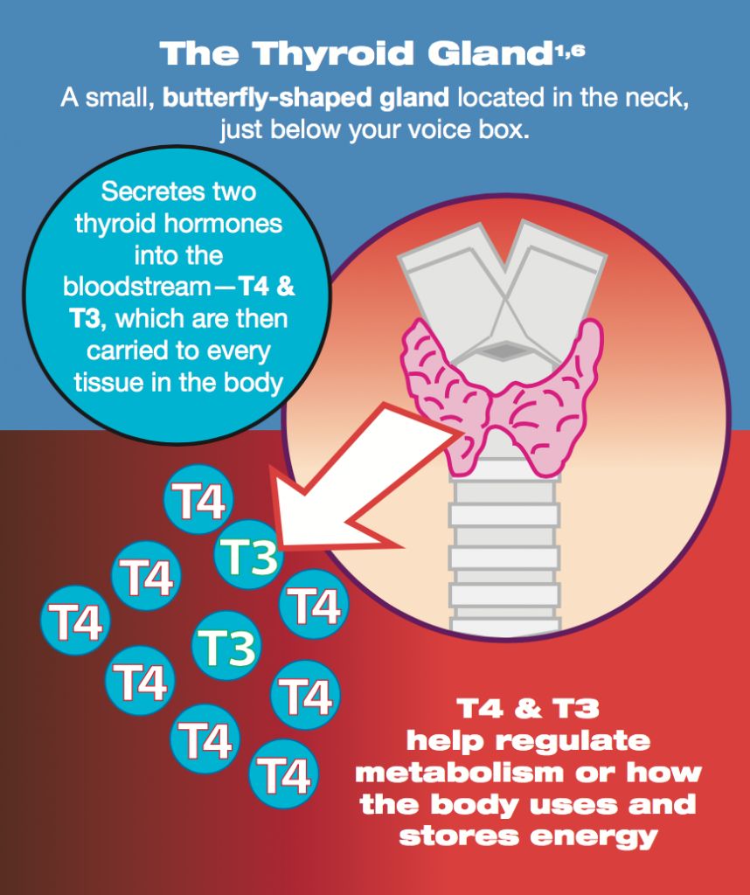

Slide 4
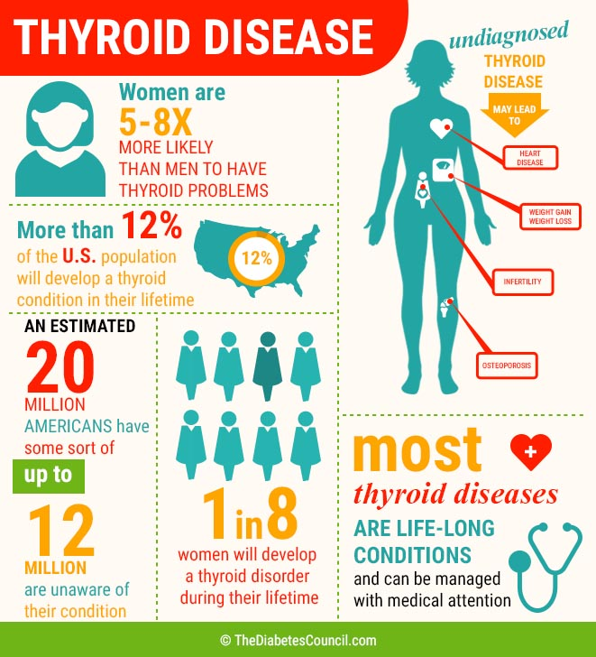

Slide 5
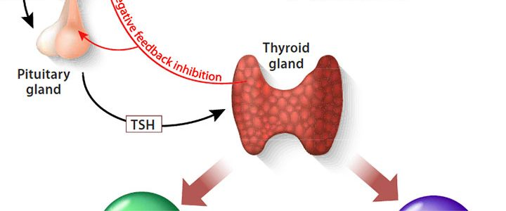
HYPOTHYROIDISM
Definition
= clinical syndrome caused by persistent thyroid hormone deficiency

Slide 6
HYPOTHYROIDISM
CLASSIFICATION
A. Primary (thyroid) hypothyroidism
1. Destruction or lack of functionally active tissue of the thyroid gland
- chronic autoimmune thyroiditis
- surgical removal of the thyroid
- radioactive therapy with 131I
- transient hypothyroidism with subacute, postpartum and silent ("painless") thyroiditis
- agenesis and thyroid dysgenesis
2. Disturbance of thyroid hormone synthesis
- congenital defects of thyroid hormone biosynthesis
- severe iodine deficiency or excess
- drug or toxic effects (thyreostatic drugs, lithium, perchlorate, etc.)
B. Central (hypothalamic-pituitary, secondary) hypothyroidism
1. Resolution or lack of cells producing TSH or thyroliberin
- tumors
- traumatic or lumen injury (surgery, proton therapy)
- vascular disorders (ischemic or hemorrhagic damage)
- infectious or infiltrative processes (abscess, tuberculosis, histiocytosis)
- chronic lymphocytic hypophysitis
- congenital disorders
- mutations
- drug and toxic effects

Slide 8
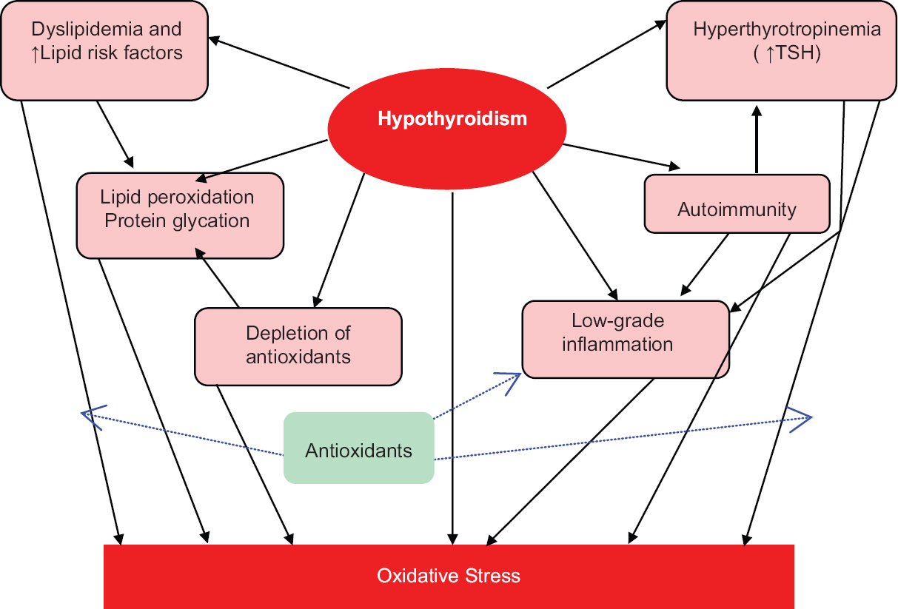
HYPOTHYROIDISM
PATHOGENESIS

Slide 9
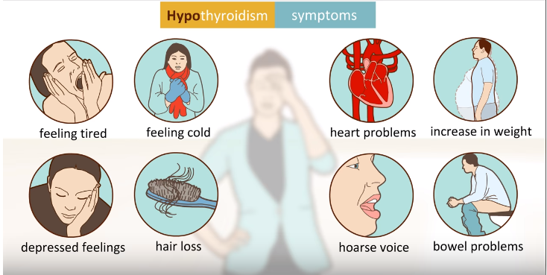

Slide 10
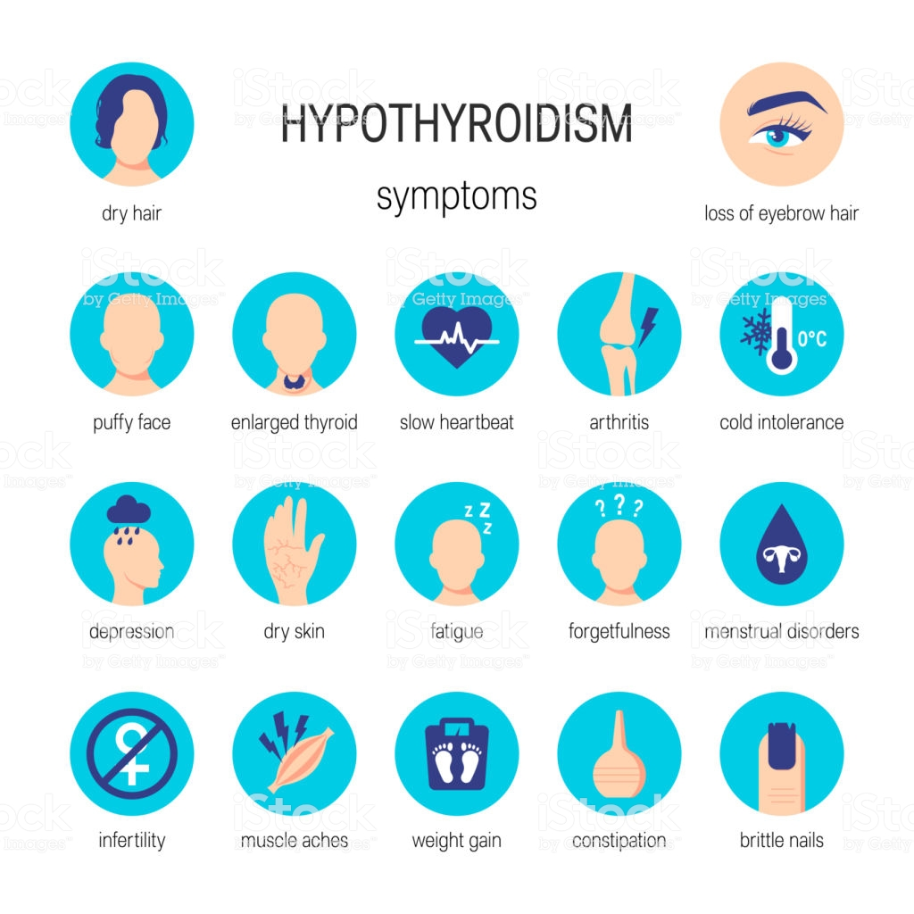

Slide 11
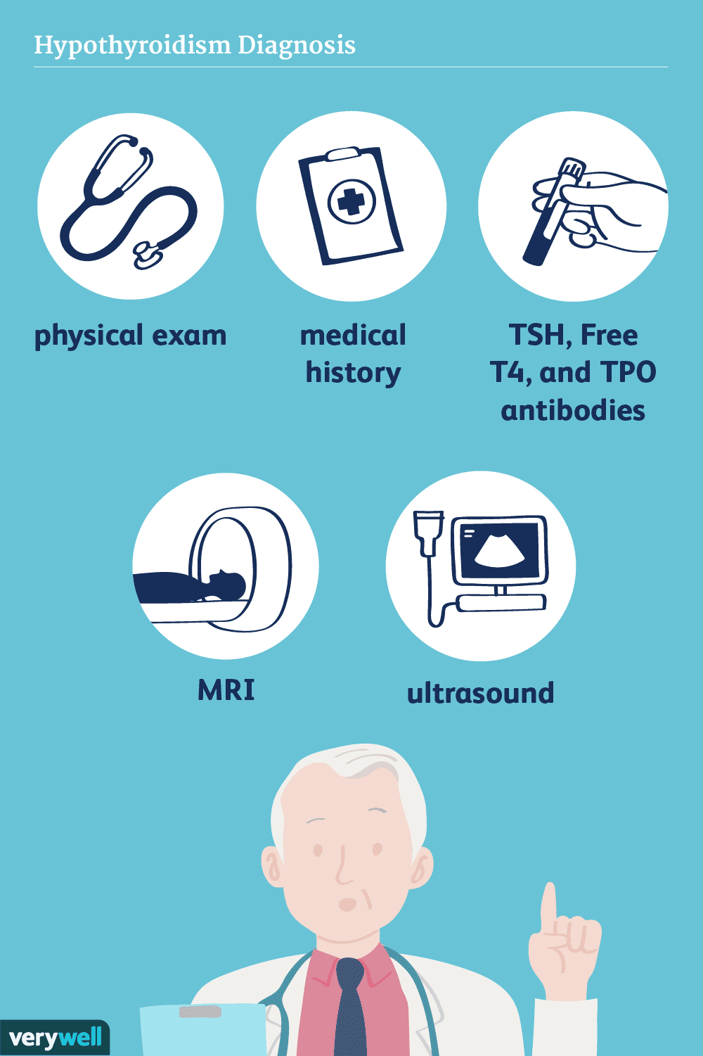
HYPOTHYROIDISM
DIAGNOSTICS

Slide 12
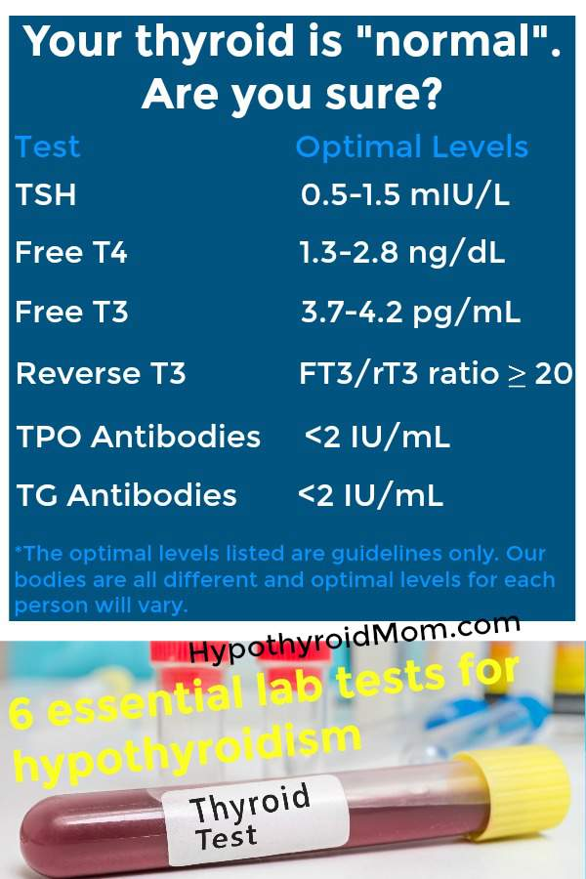
LABORATORY INVESTIGATIONS
1. PRIMARY HYPOTHYROIDISM
TSH INCREASE
T4 DECREASE
T3 DECREASE
2. SECONDARY HYPOTHYROIDISM
TSH DECREASE
T4 DECREASE
T3 DECREASE

Slide 13
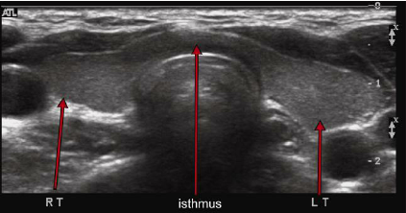
INSTRUMENTAL INVESTIGATIONS
ULTRASOUND OF THYROID
thyroid reduction
there may be nodular cystic formations

Slide 14
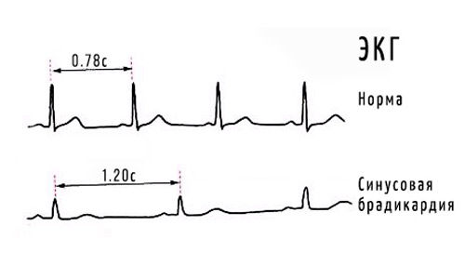
INSTRUMENTAL INVESTIGATIONS
2. ECG
sinus bradycardia
reduction of teeth voltage

Slide 15
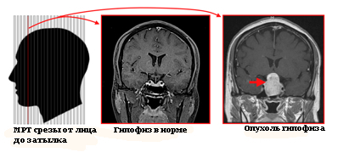
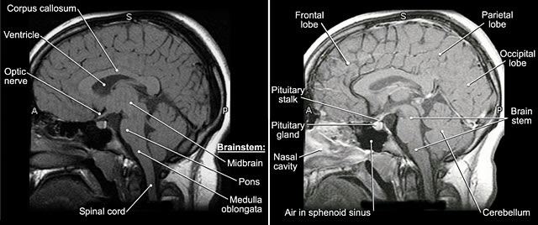
INSTRUMENTAL INVESTIGATIONS
3. MRT
pituitary adenoma

Slide 16
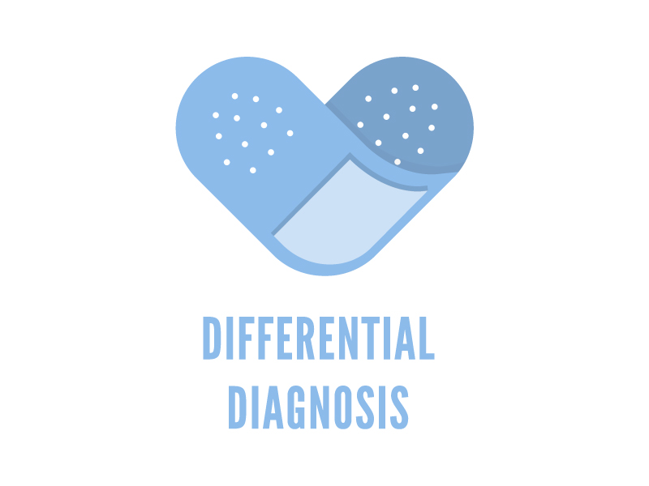
HYPOTHYROIDISM
DIFFERENTIAL DIAGNOSIS
1. Autoimmune thyroiditis
- if chronic AIT, then it is irreversible and the patient should receive replacement therapy for life
- while hypothyroidism is usually terminated by the restoration of the thyroid gland
2. Primary and secondary hypothyroidism
- secondary - uninsulated, combined with the secondary failure of other endocrine glands (hypocritisism, hypogonadism).
- normal level of TSH can sometimes be

Slide 17
HYPOTHYROIDISM
DIFFERENTIAL DIAGNOSIS
Gastroenterological:
constipation, biliary tract dyskinesia, cholelithiasis, chronic hepatitis (jaundice combined with elevated hepatic transaminase);
Cardiac:
diastolic hypertension, dyslipidemia, hydropericardium;
Respiratory:
sleep apnea syndrome, pleural effusion of unknown origin, chronic laryngitis;
Neurological:
tunnel syndromes (carpal canal, peroneal canal nerve);
Rheumatological:
polyarthritis, polysinovitis, progressive osteoarthrosis (often adjacent to neurological masks);
Gynecological:
menstrual disorders (amenorrhea, polymenorrhea, hypermenorrhea, menorrhagia, dysfunctional uterine bleeding), infertility;
Hematologic:
normochromic normocytic, iron hypochromic or macrocytic B12 deficiency anemia;
Psychiatric:
depression, dementia.

Slide 18
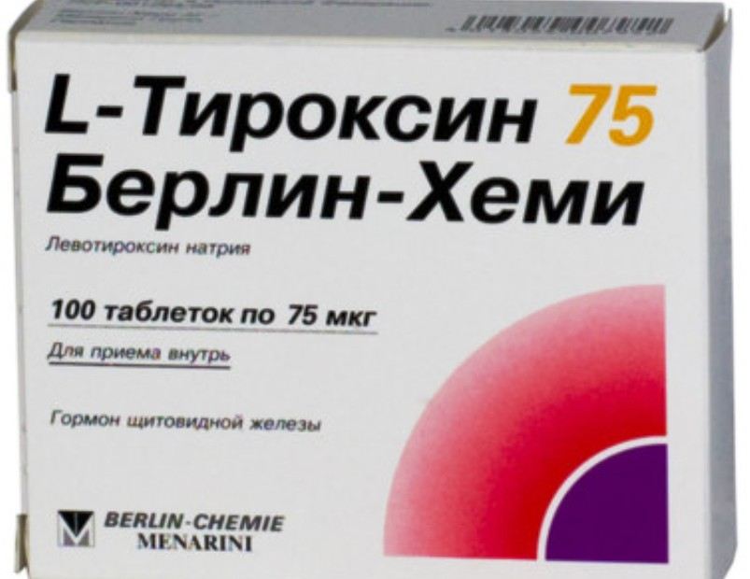
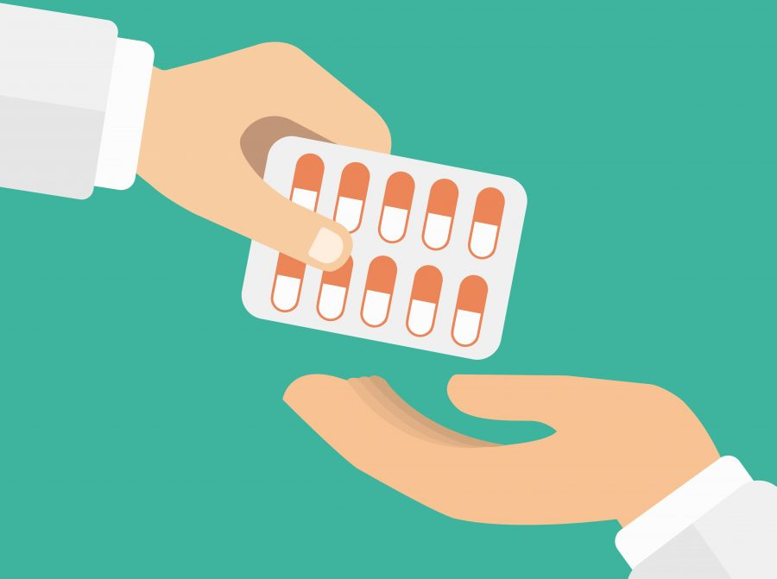
HYPOTHYROIDISM
TREATMENT
LEVOTIROXIN (L-T4)
Pharmacological action - compensating for the deficiency of thyroid hormones.
Inside, in the morning, on an empty stomach, washed down with a small amount of liquid.
Tablets should be taken regularly.
FOR WOMAN = 100 MG/DAY
FOR MAN = 150 MG/DAY

Slide 19
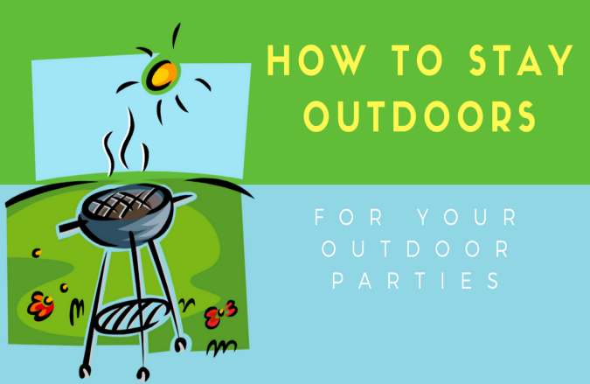
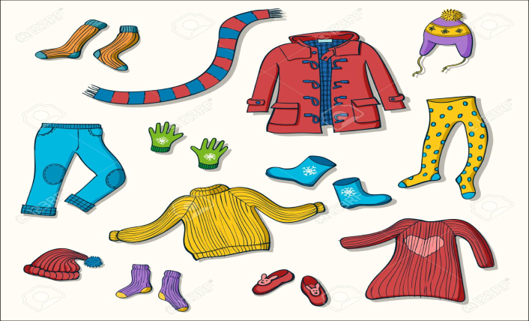
CONCLUSION
Low-fat diet with plenty of fiber
Patients activation
Outdoor stay
Wearing warm clothes

Slide 20
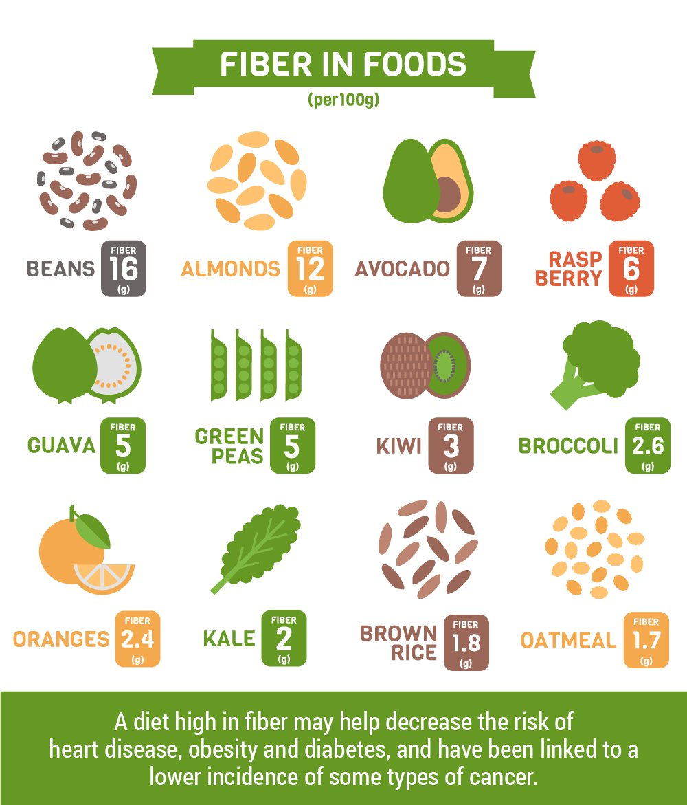

Slide 21
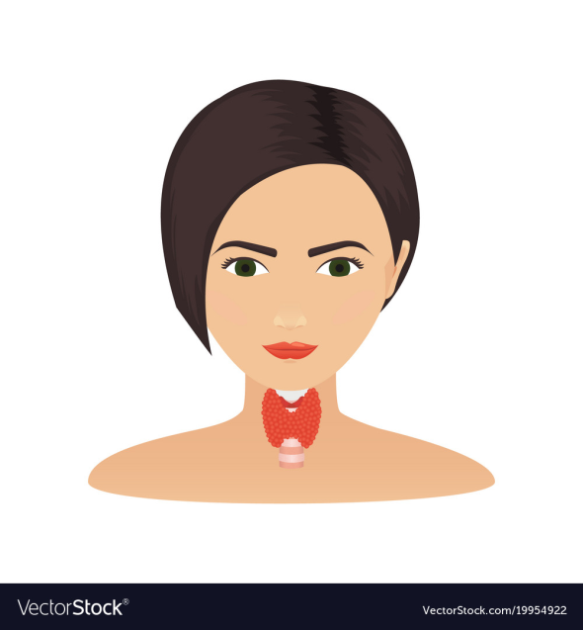
DIFFUSE TOXIC GOITER
Definition
= systemic autoimmune disease, which develops as a result of the production of stimulating antibodies to the thyroid hormone receptor (AB – pTSH) , is clinically manifested by the defeat of the thyroid gland with the development of thyrotoxicosis syndrome in combination with extrathyroid pathology

Slide 22
CAUSES
Iodine deficiency
Autoimmune disease
Women over the age of 40
GRAVES’ DISEASE
Hyperthyroidism
Other causes
Smoking
Hormonal changes
Thyroiditis
Lithium
Overconsumption of iodine
Radiation therapy

Slide 23
PATHOGENESIS

Slide 24
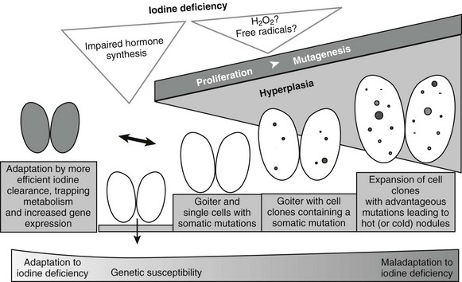
PATHOGENESIS

Slide 25
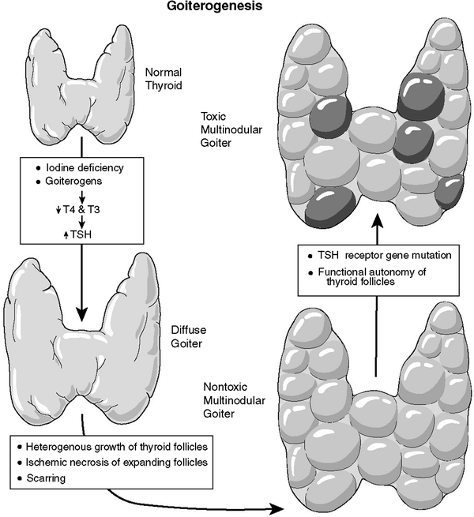
PATHOGENESIS

Slide 26
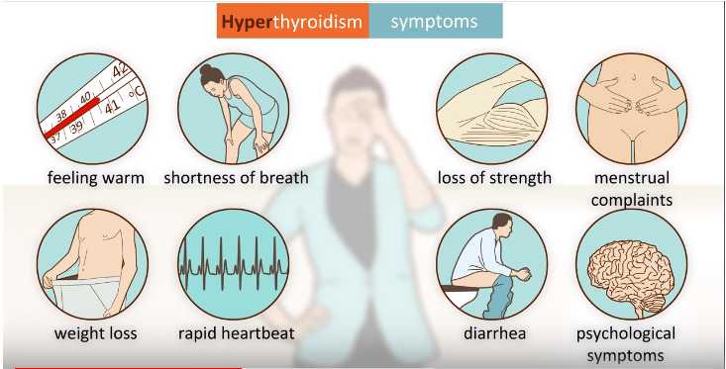

Slide 27
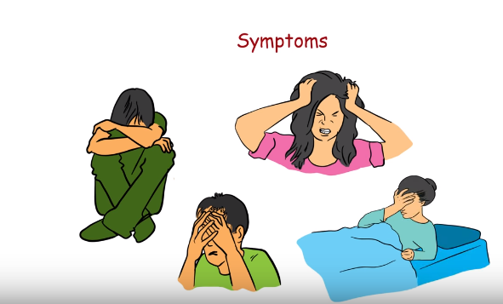

Slide 28
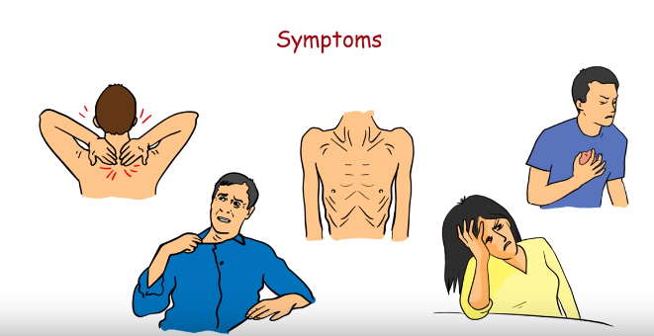

Slide 29
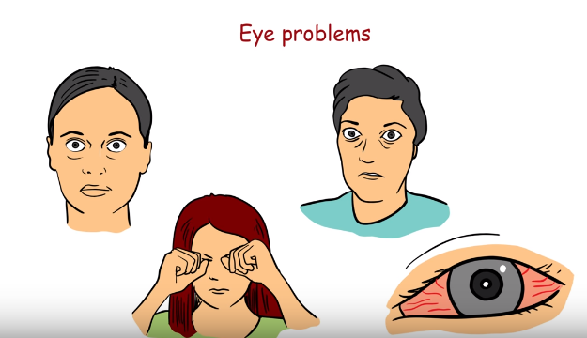

Slide 31
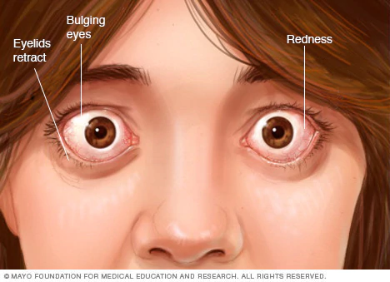
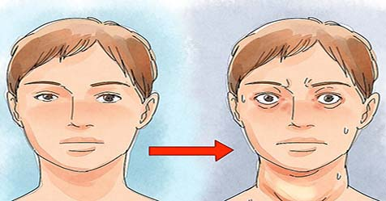

Slide 32
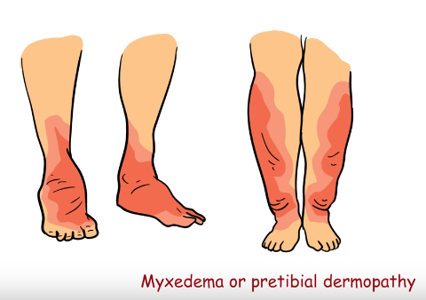

Slide 33
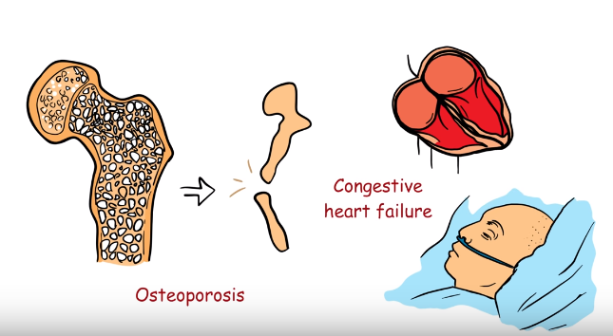

Slide 35
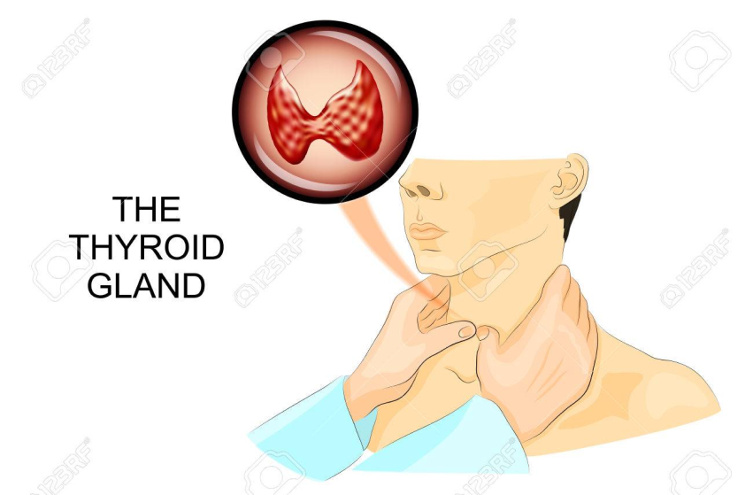
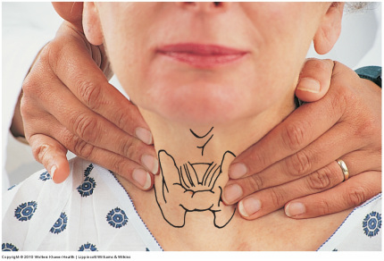
THYROID GLAND PALPATION
Goiter size classification (WHO)
0 - no goiter
I - the size of the goiter is larger than the distal phalanx of the doctor’s thumb, the goiter is palpable but not visible
II - goiter is palpable and visible to the eye

Slide 36
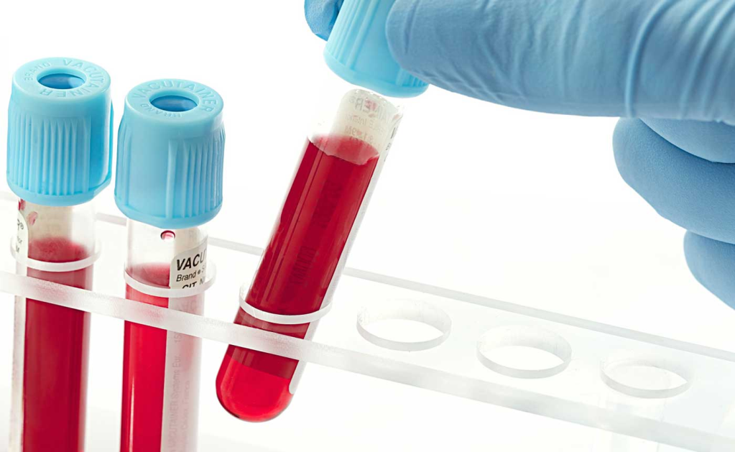
Study of functional activity of the thyroid gland
Thyroid hormones in the blood
TSH DECREASE (<0,1 mE/l)
T3 INCREASE
T4 INCREASE

Slide 37
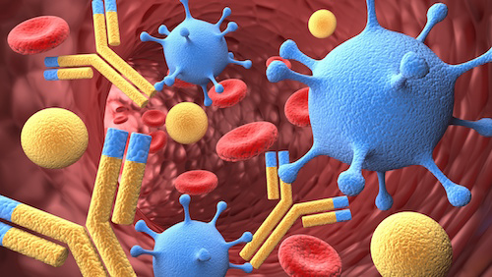
Study of immunological markers
ANTIBODIES TO r-TSH - 99-100%
ANTIBODIES TO TPO (TYREOPEROXIDASE)
– 40-60%

Slide 38
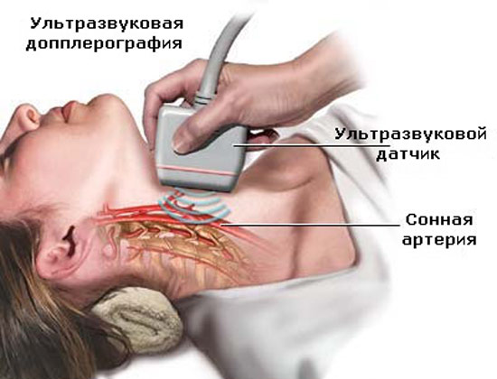
INSTRUMENTAL INVESTIGATIONS
USI OF THYROID GLAND
decreased echogenicity
NORMAL VOLUME OF TG
FEMALE = 18 ml
MALE = 25 ml

Slide 39
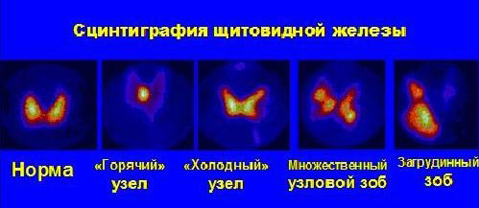
INSTRUMENTAL INVESTIGATIONS
THYROID SCINTIGRAPHY
Use technetium isotope (99mTc)
Disease = Equable isotope distribution

Slide 40
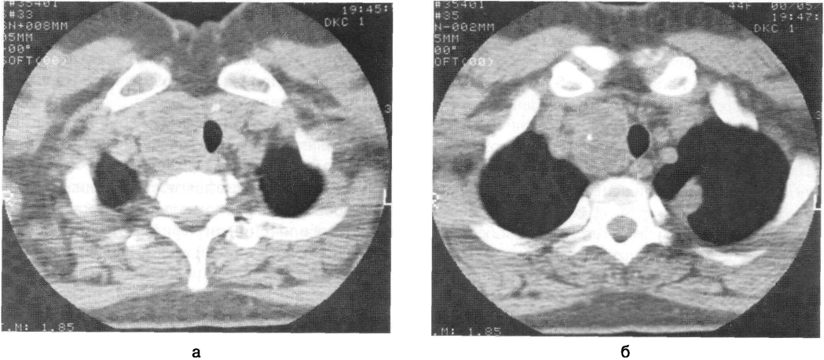
INSTRUMENTAL INVESTIGATIONS
CT
MRT
RETROSTERNAL GOITER
DISPLACEMENT AND RELEASE OF TRAHEA AND ESOPHAGUS

Slide 41
DIFFERENTIAL DIAGNOSTICS
Thyrotoxicosis due to destruction of thyroid tissue
Painless silent thyroiditis
Subacute thyroiditis
Radiation thyroiditis
Postpartum thyroiditis
Thyrotoxicosis caused by excessive proliferation of TSH (TSH-producing pituitary adenoma, hypophysial resistance to thyroid hormones)
Artificial thyrotoxicosis

Slide 43
NON-MEDICAL TREATMENT
Limiting physical activity
To give up smoking

Slide 44
MEDICAL TREATMENT
RECEPTION OF THYROESTATICS
THERAPY 12-18 MONTHS
Tiamazol (tyrosol, merkazolil)
Propylthiouracil
Beginning
+ relatively large doses: 30-40 mg (2 times) or propylthiouracil 300-400 mg (3-4 times)/
Lasts 3-4 months
+ B – blockers – ANAPRILIN 120 mg/day 3-4 times; CONCOR 5 mg/day; ATENOLOL 100 mg/day 1 time.
+ GCS if severe prolonged thyrotoxicosis – PREDNIZOLON (10-15 mg/day) or HYDROCORTIZON (50-70 mg/day)
SCHEME "BLOCK AND REPLACE"
If T4 = NORMAL we decrease dose after 2-3 weeks – SUPPORTIVE THERAPY
+ TIAMAZOL 10 mg/day/
+ LEVOTHYROXIN 25-50 mcg/day

Slide 45
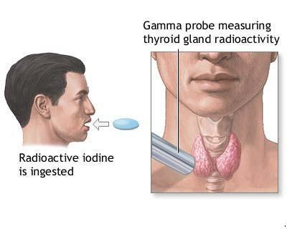
THERAPY WITH 131 I
In case of recurrence of thyrotoxicosis
WAY = destruction of hyper functioning thyroid tissue

Slide 46
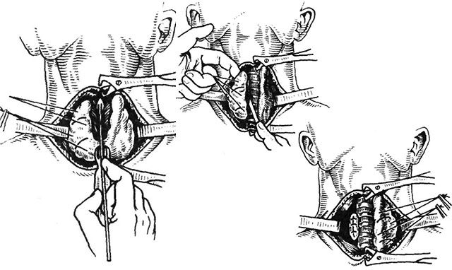
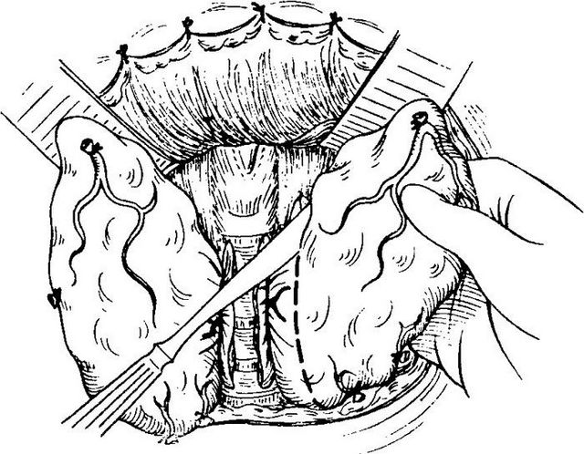
SURGICAL TREATMENT
Indications:
lateral goiter, diffuse and nodular forms of goiter
FIRST: Achievement of euthyroid state
Surgery

Slide 47
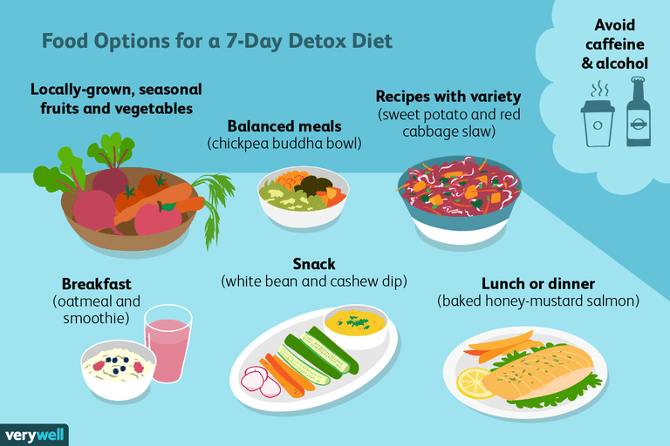

Slide 48
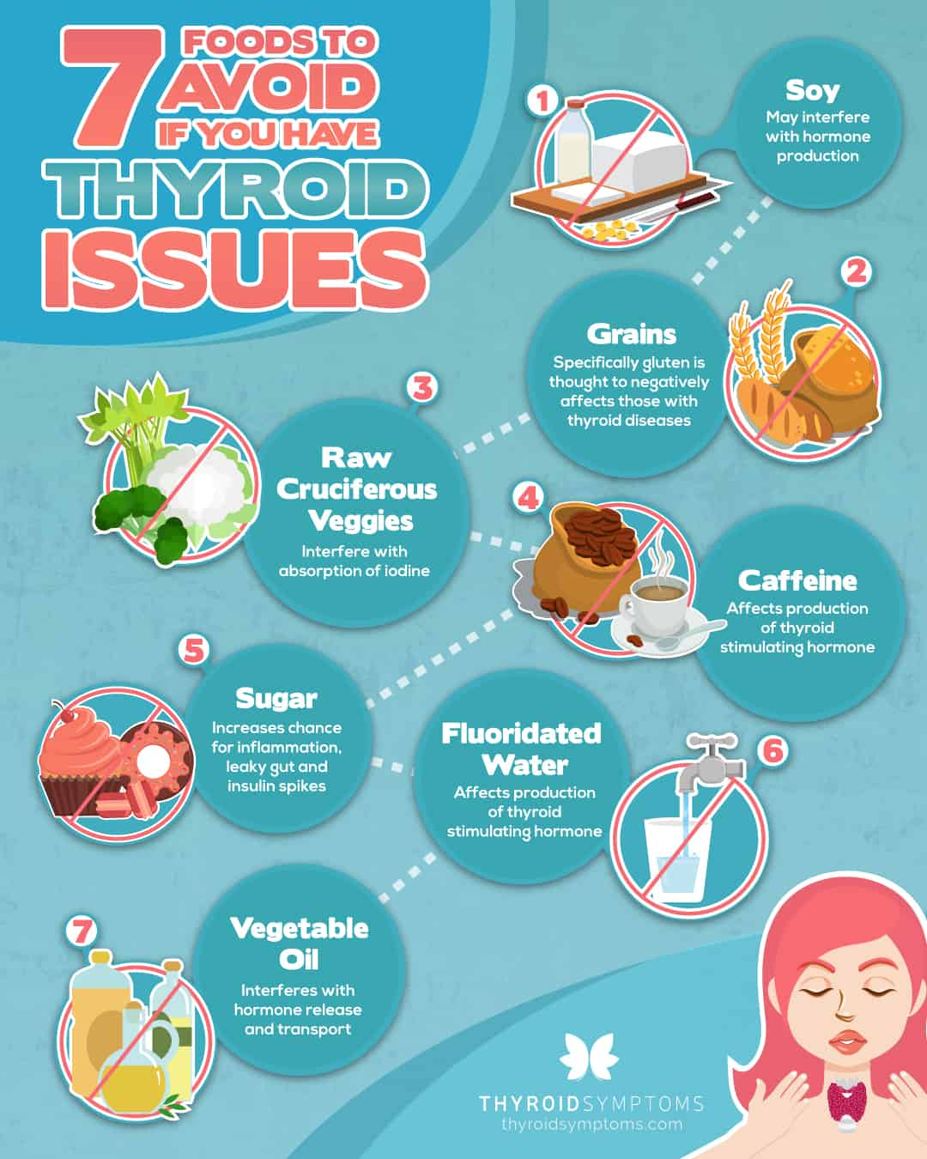

Slide 49
BIBLIOGRAPHY
Дедов И.И. Эндокринология 3-е издание
Федеральные клинические рекомендации по диагностике и лечению токсического зоба.
Е.А. Трошина, Н.Ю. Свириденко, В.Э. Ванушко, П.О. Румянцев, В.В. Фадеев, Н.А. Петунина

